Slide 1


ZeroWaste: Solving the Food Waste Crisis in Uzbekistan
FEBA team

Slide 2




📌 Near-Expiry Stock
Environmental
damage
Waste
Expiring food
Loss
04

Slide 3
Near-Expiry Product Marketplace
✅ A digital platform where supermarkets sell
near-expiry products at discounted prices.
💡 Key Benefits:
Helps supermarkets reduce waste & financial losses.
Enables customers to buy affordable food.
Supports a sustainable, zero-waste economy.

Slide 4

Green-Tech in Action 🌱
Step 1: Smart Inventory Tracking
Step 2: AI-Powered Discounts
✅ Supermarkets update stock in real time using IoT sensors & barcode scanning to track near-expiry products.
🧠 AI analyzes expiry dates, demand, and stock levels to suggest the best discounts, reducing food waste.
Step 3: Eco-Friendly Shopping
Step 4: Automated Waste
Reduction
📲 Customers browse & buy discounted items through the app/website, making sustainable shopping easy.
♻️ The system updates stock automatically, preventing overstocking and reducing landfill waste.

Slide 5



We target 3 things:
NATURE
No food waste
PEOPLE
Food for the POOR/Charity
MARKETS
Expired products = Financial loss

Slide 6
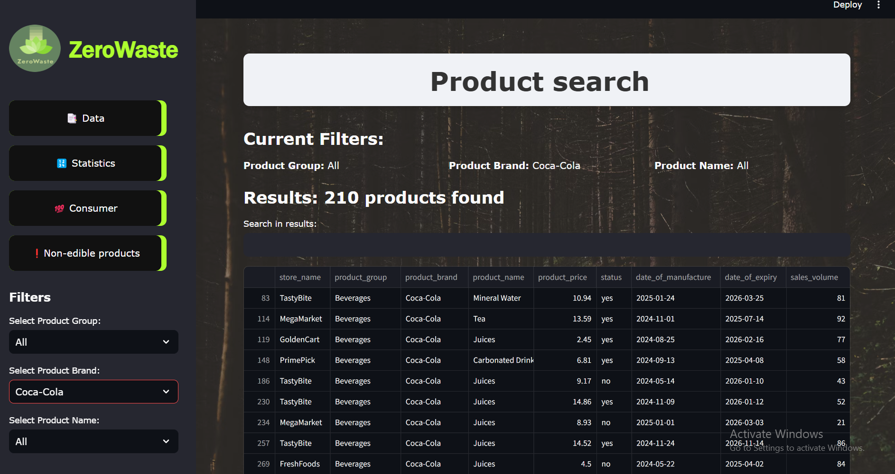

Slide 7
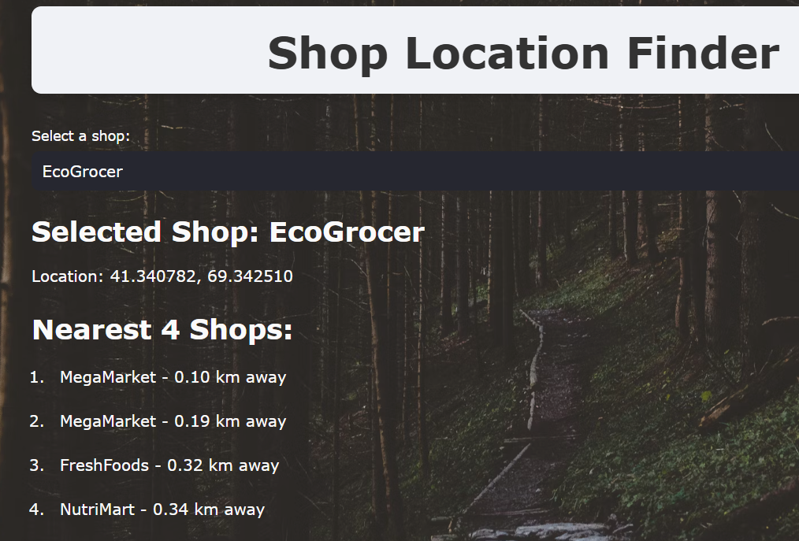
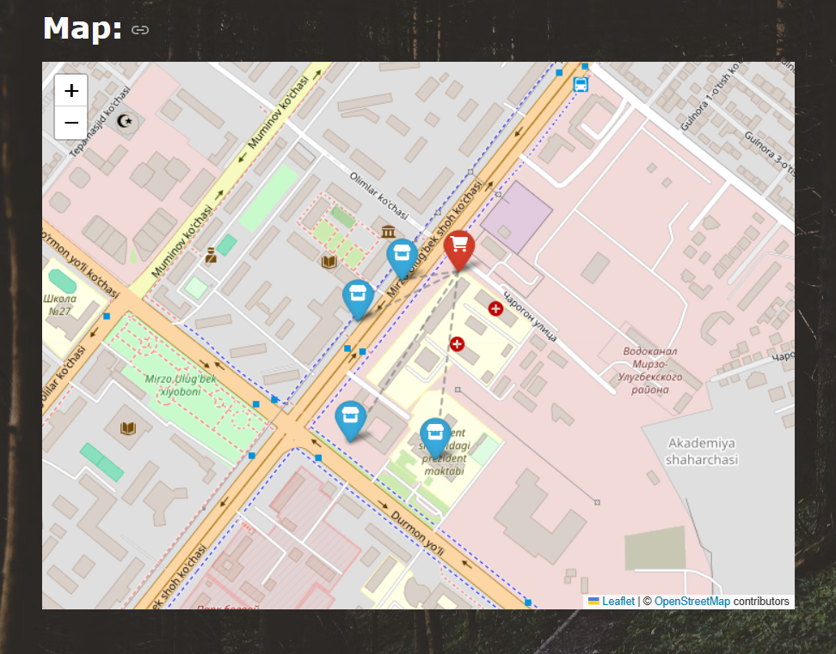

Slide 8

Target Market
Middle sized markets want our service as we help to reduce FOOD WASTE
$100K
100
SOM
$5M
500
SAM
10,000
$50M
TAM

Slide 9


Monetization:
Supermarkets pay a monthly or yearly fee
Subscription Model
Transaction Fees
supermarkets pay 10$ monthly
2-5% commission from sales

Slide 10
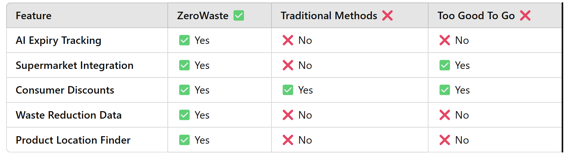
📊 Competitive Advantage
🏆 How We Stand Out:

Slide 11

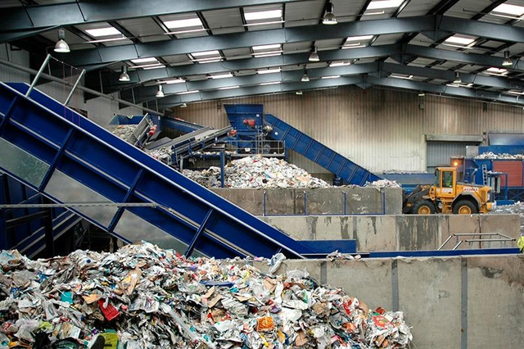

What happens if even near-expiry products are not sold?
We integrate our platforms for Waste Management
FARMS
WASTE DISPOSAL
RECYCLING PRODUCTS

Slide 12

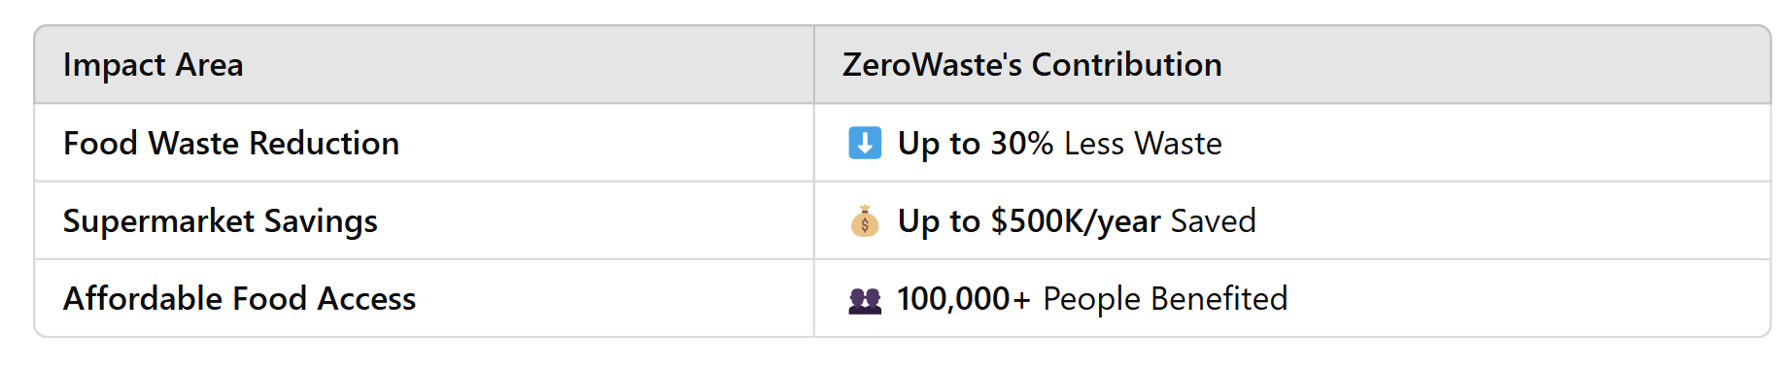

BENEFITS:

Slide 13
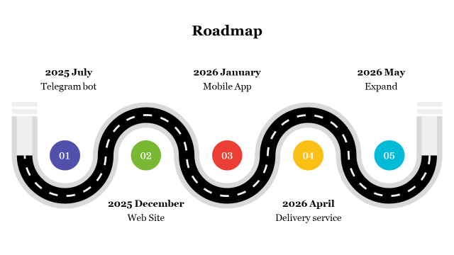

Slide 14

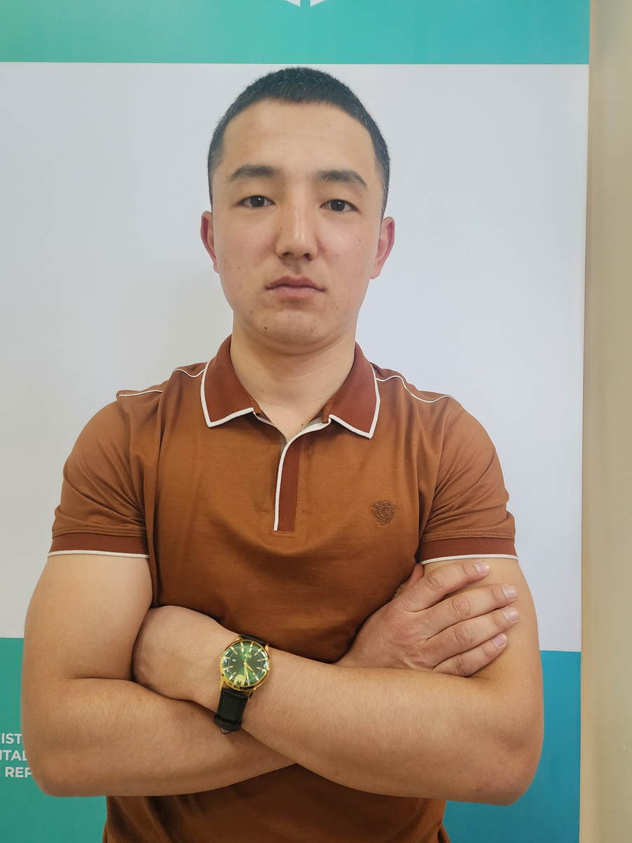

Our Team
Marjona Murodova
Ibragimov Diyorbek
Shuxratov Shoxijaxon
Project Manager
4 years experience in PM,
Business strategy, Public Relations expert
Backend developer, 3 years experience in IT, Product developer
Data analyst
Frontend developer,
3 years experience in
real IT projects, Full stack developer,
Data scientist

Slide 15


Thank you for your attention!
Contact Us
FEBA team
Project manager
+998901108993
www.feba_team.uz

